Slide 1




Functional Data Analysis for the Australian Grains Industry
Dr Braden J. Thorne Prof. Adam Sparks

Slide 2
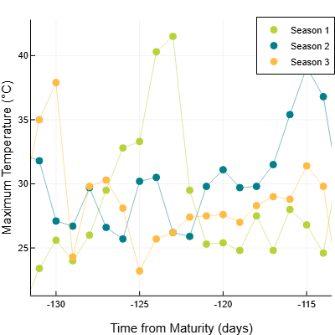
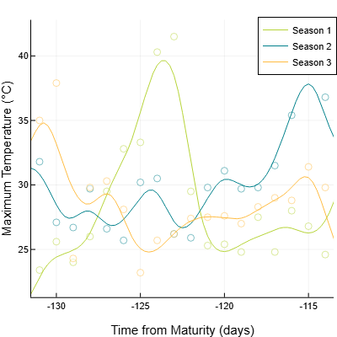
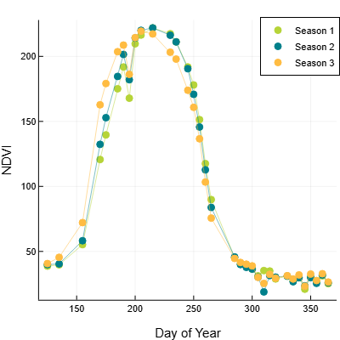
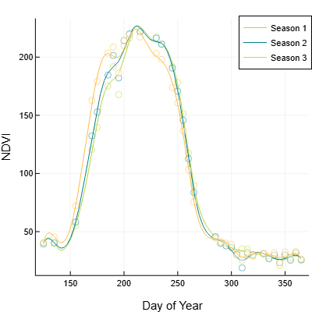
Point Data
Functional Data
Observations are samples of a pointwise distribution:
Analyse the points directly, or
Summarise observations over time
Observations are samples of some underlying function:
Function is a sample from a distribution.
Aim to compare the underlying functions
Curve fitting
Interpolation
Smoothing

Slide 3
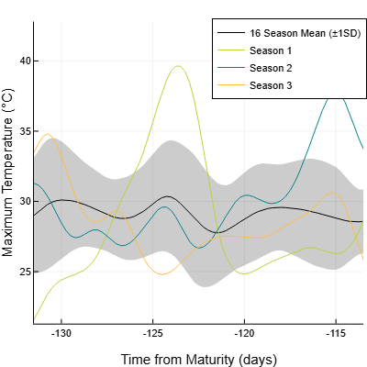
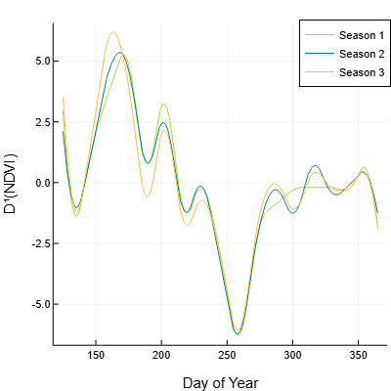
Functional Data Analysis
Qualitative
Mean and variance functions
Derivatives (D^{n})
Quantitative
Regression
Principal component analysis
T-tests and ANOVA
Software
56* functional data packages in R
fda, fdANOVA, refund, …
Scikit-FDA for Python

Slide 4
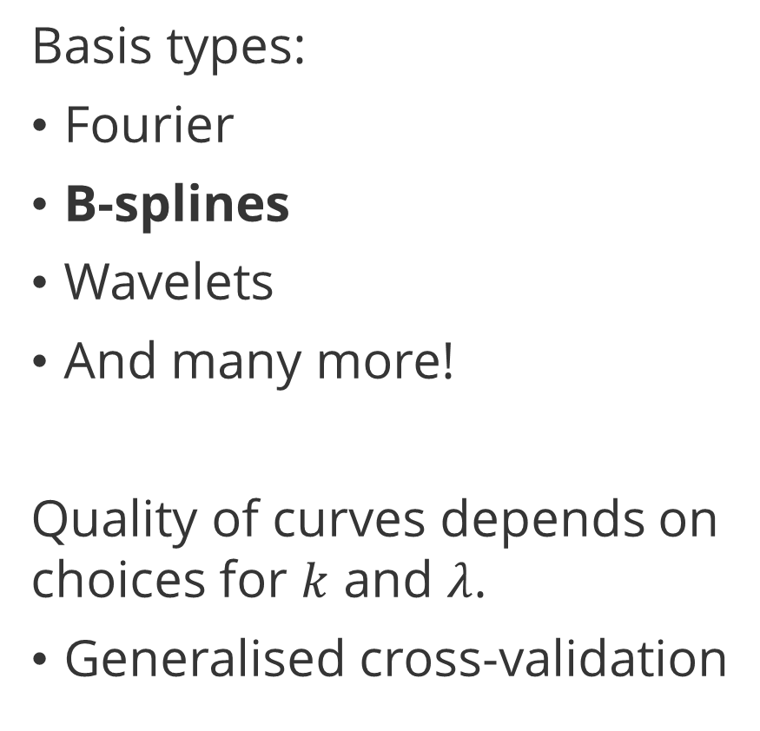
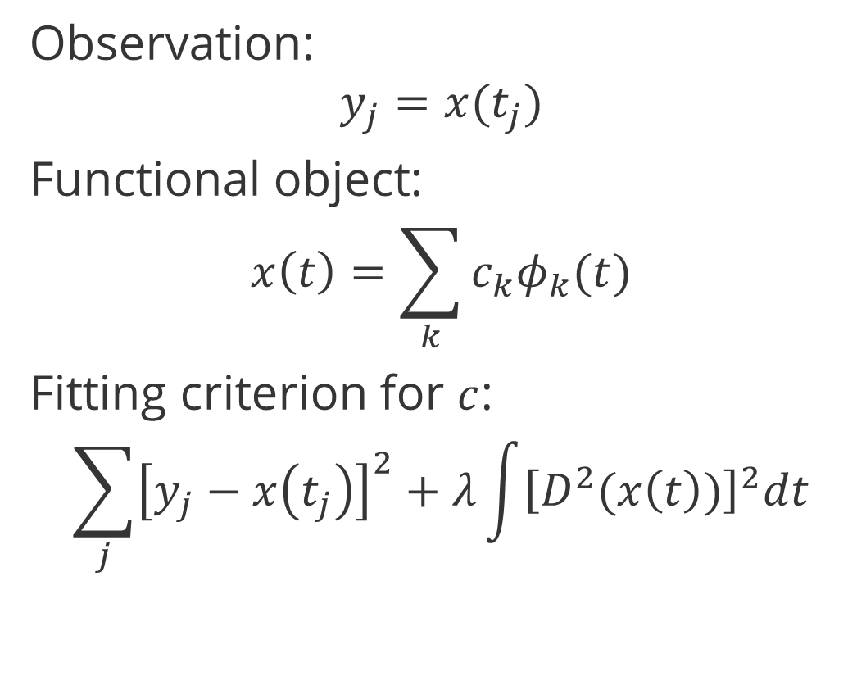
Extracting Functional Data
Observation:
$$y_{j}=x(t_{j})$$
Functional object:
$$x\left(t\right)=\sum_{k}{c_{k}φ_{k}(t)}$$
Fitting criterion for $c$:
$$\sum_{j}{{\left[y_{j}−x\left(t_{j}\right)\right]}^{2}}+λ\int{{\left[D^{2}(x\left(t\right))\right]}^{2}dt}$$
Basis types:
Fourier
B-splines
Wavelets
And many more!
Quality of curves depends on choices for $k$ and $λ$.
Generalised cross-validation
Error penalty
Roughness penalty

Slide 5
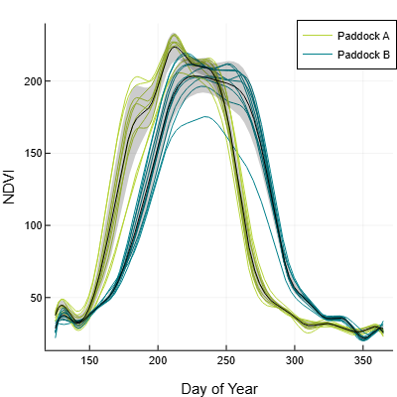
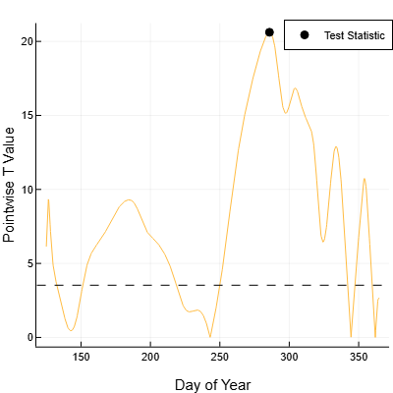

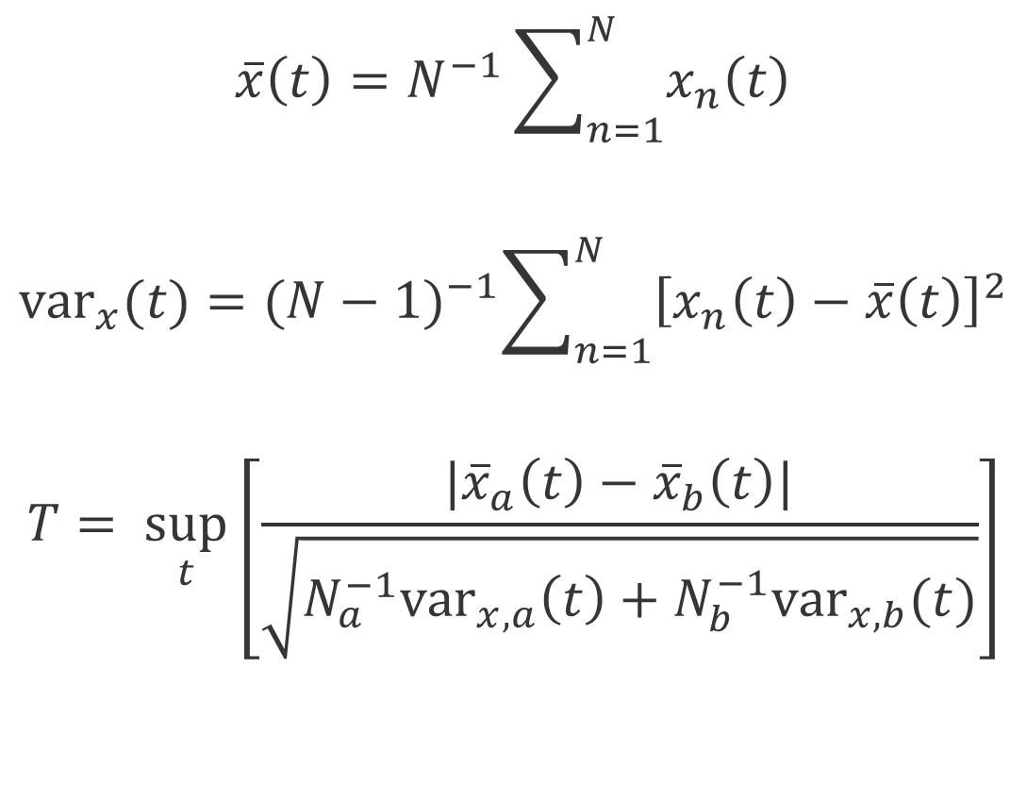
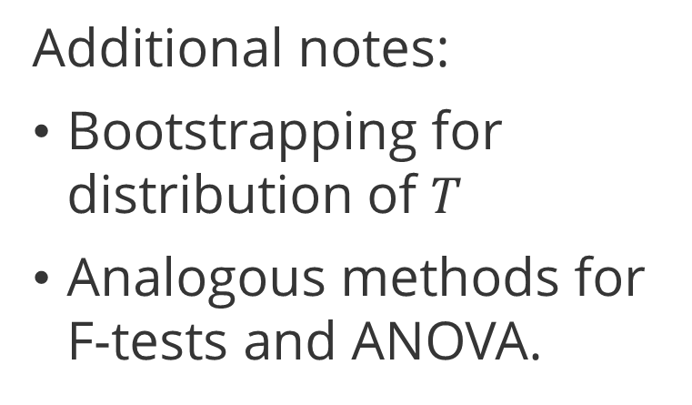
Functional (T-)Testing Procedure
$$\overline{x}\left(t\right)=N^{−1}\sum_{n=1}^{N}{x_{n}\left(t\right)}$$
$${var}_{x}(t)={(N−1)}^{−1}\sum_{n=1}^{N}{{\left[x_{n}\left(t\right)−\overline{x}\left(t\right)\right]}^{2}}$$
$$T= \sup_{t}\left[\frac{|{\overline{x}}_{a}\left(t\right)−{\overline{x}}_{b}\left(t\right)|}{\sqrt{N_{a}^{−1}{var}_{x,a}\left(t\right)+N_{b}^{−1}{var}_{x,b}(t)}}\right]$$
Additional notes:
Bootstrapping for distribution of $T$
Analogous methods for F-tests and ANOVA.
Point-wise $T$ values

Slide 6
Charcoal Rot
Functional analysis of weather variables and their link to charcoal rot severity in soybean
GRDC Project UOM2401-002RTX

Slide 7
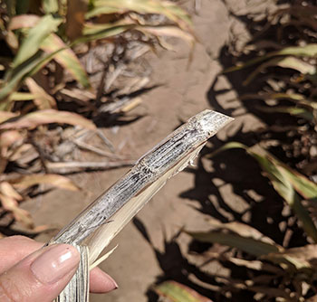
Charcoal Rot Overview
Caused by species Macrophomina
M. phaseolina
M. tecta
Significant disease of summer crops, e.g.
Sorghum
Soybean
Favours hot, dry conditions
Especially later in the season
Lack of effective management practices***
Photo: Dr Niloofar Vaghefi
“Discovery opens new front on charcoal rot research”, GRDC Groundcover

Slide 8
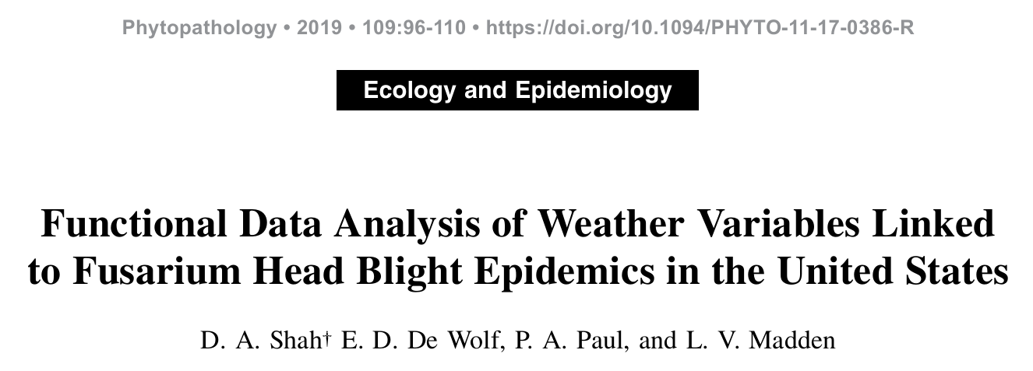

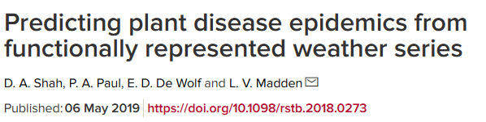
Methodology

Slide 9
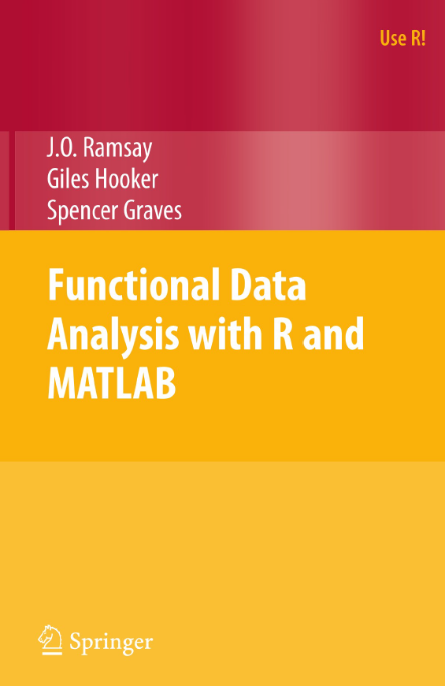
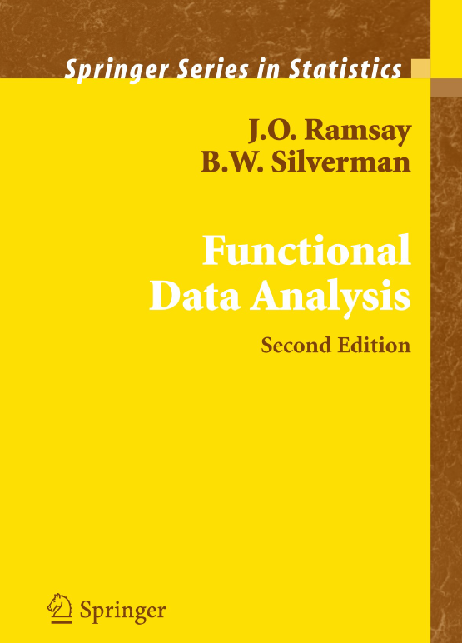
Methodology

Slide 10
Experimental Setup
Functional Modelling
Linear Mixed Modelling (LMM)
16 years of historical daily weather data from Grafton, NSW
Temperature - min, max, diff, avg
Rainfall
Relative humidity
Southern oscillation index (SOI)
Seasonal charcoal rot ratings in Soybean (1-5) → severity rating (high, low)
Filter from 140 days prior to 8 days post maturity for Soybean crop
Functional T-test on smoothed data and their derivatives
Identify critical timing for significant factors
Experimental trial results over 16 seasons
3x Soybean varieties
4x Reps per year
Yield and seed size recorded
LMM analysis with ASReml
Include critical weather factors

Slide 11
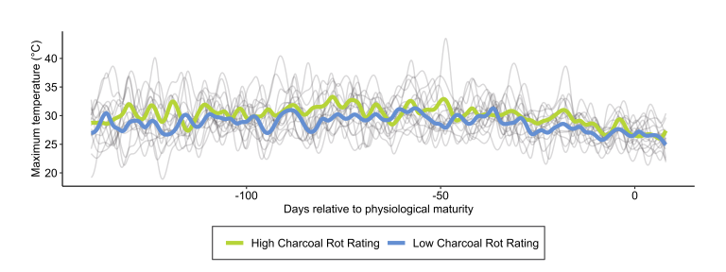
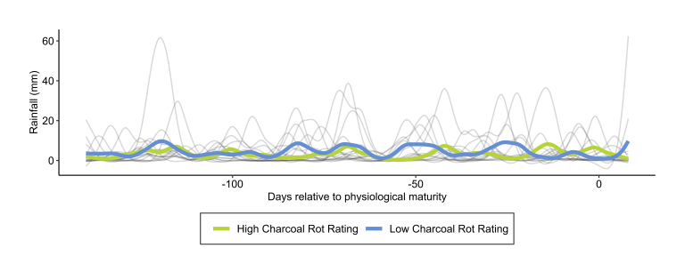
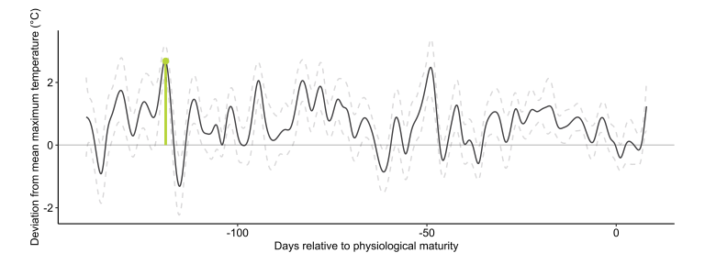
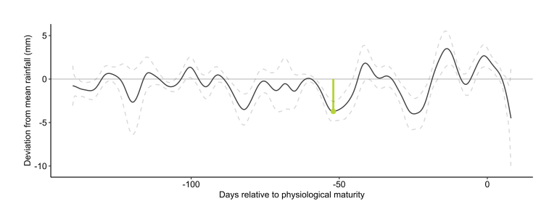
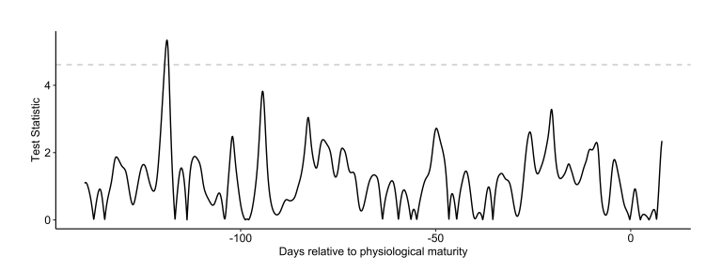
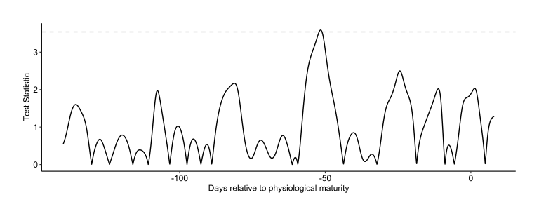
FDA Results
Significant:
Maximum temperature
D¹(Maximum temperature)
Rainfall
Not significant:
D¹(Rainfall)
All other temperature measurements
Relative humidity
SOI
All other derivatives

Slide 12
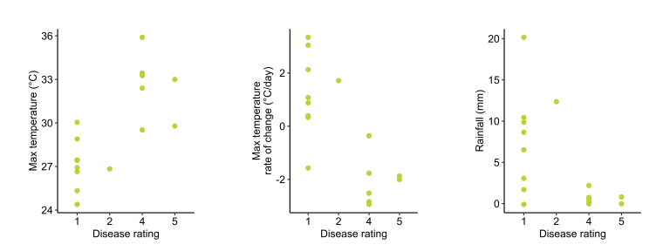
LMM Results
Source of Variation | Yield p-Values | Seed Size p-Values
Variety | <0.001 (***) | <0.001 (***)
Maximum Temperature | <0.001 (***) | <0.001 (***)
D¹(Maximum temperature) | 0.476 | 0.034 (*)
Rainfall | 0.187 | 0.002 (**)
Variety : Maximum Temperature | 0.350 | 0.523
Variety : D¹(Maximum temperature) | 0.270 | 0.125
Variety : Rainfall | 0.563 | 0.101

Slide 13

Frost and Stubble
Assessing the impact of stubble management practices on temperature dynamics to understand frost risk in broadacre crops
GRDC Project LIE2110-001SAX

Slide 14
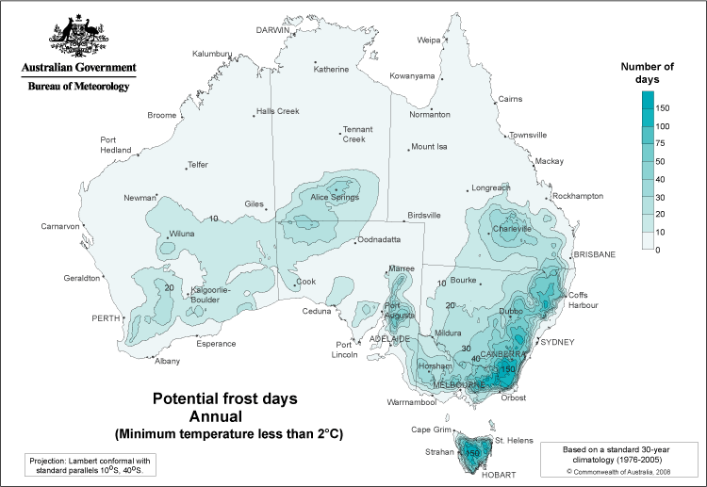
Frost and Stubble Overview
Australian frost losses in hundreds of millions of dollars (annually)
Frost likelihood and severity influenced by
Local climate
Elevation
Management practices
Impacts of stubble retention:
Image: Bureau of Meteorology
Benefits | Issues
Reduced soil and moisture erosion | Improved environment for pests (e.g. mice)
Improved moisture infiltration and retention | Increased risk of disease carryover
Increased soil organic matter | Additional machinery challenges
Increased biological activity | Increased impact and duration of frost events
Source: GRDC WA Stubble Retention Guide, 2023

Slide 15
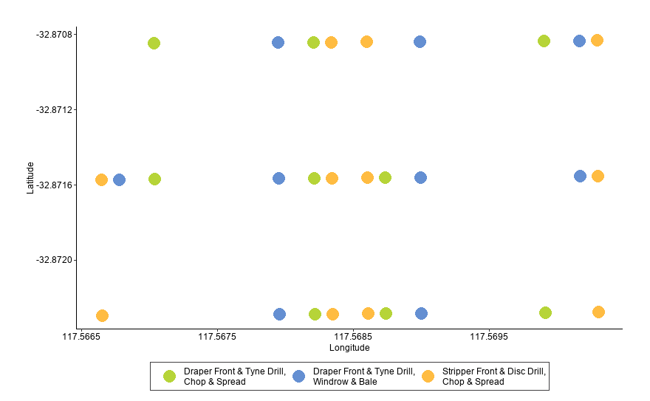
Experimental Setup
3 stubble management practices:
Draper front, tyne drilling, chop/spread
Draper front, tyne drilling, windrow/bale
Stripper front, disc drilling, chop/spread
3 treatments, 4 reps → 12 strips
3 loggers per strip
5 loggers excluded due to malfunction
Temperature collected in 10min intervals from May 29th to Oct 17th.
Data smoothed then analysed via functional ANOVA methods.

Slide 16
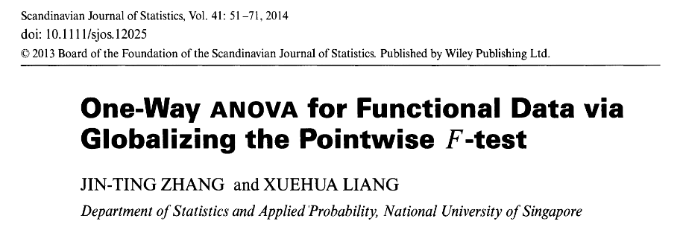
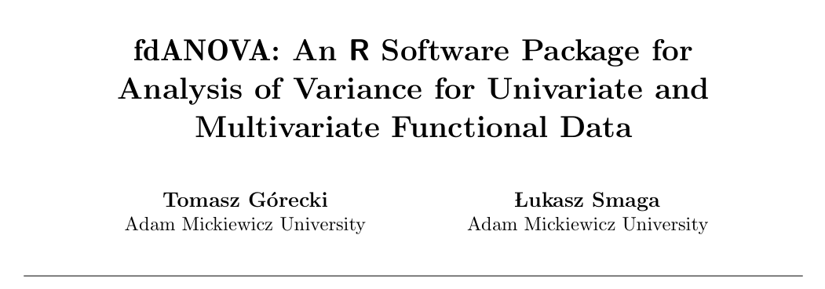
Methodology

Slide 17
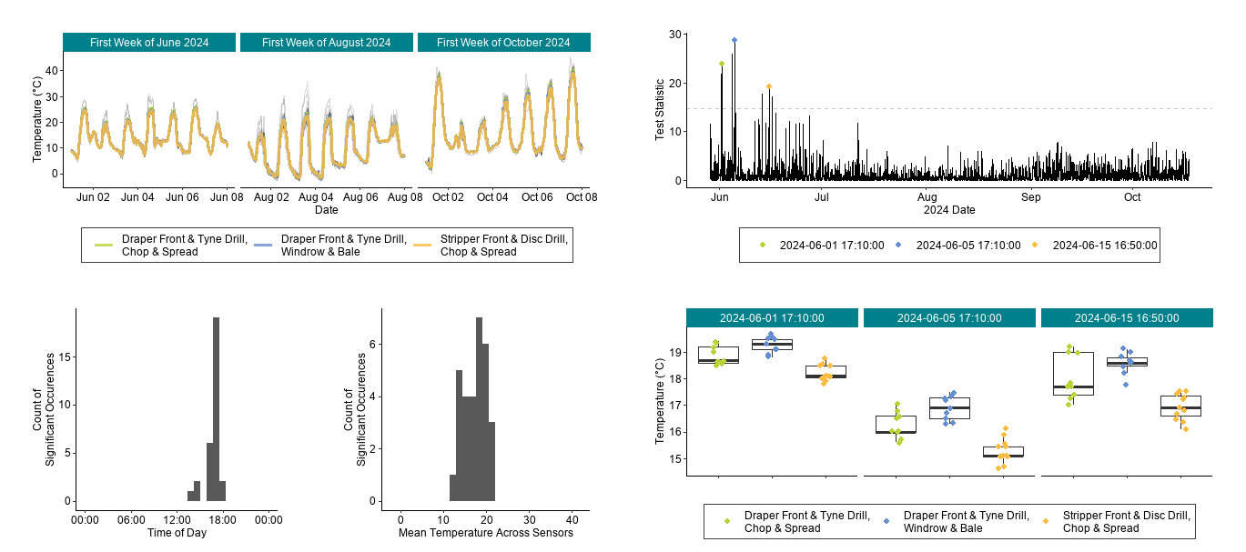
Temperature Results

Slide 18
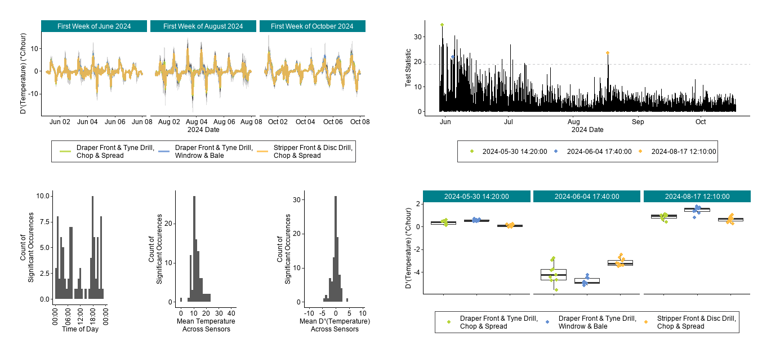
D¹(Temperature) Results

Slide 19
Summary
FDA has multiple applications within grains industry
Disease monitoring
Frost management
Future grains research
Extend to other tasks
Analysis of spectral channel data
Crop condition monitoring with NDVI
Incorporation of more sophisticated analysis methods
Functional mixed models

Slide 20

Future FDA Research
Connect FDA to nonlinear time series analysis
Surrogate testing
Ordinal network analysis
Recurrence quantification analysis
Julia implementation of FDA methods

Slide 21
Thank you!
Dr Niloofar Vaghefi
Dr Natalie Moore
Sam Blanch
Chris O’Callaghan
Amber Martin
Tina Astbury
Dr Sandra Tanz
Matt Nguyen
Prof. Mark Gibberd
A. Prof. Julia Easton

